Slide 1
www.socraticmethodists.org

Slide 5
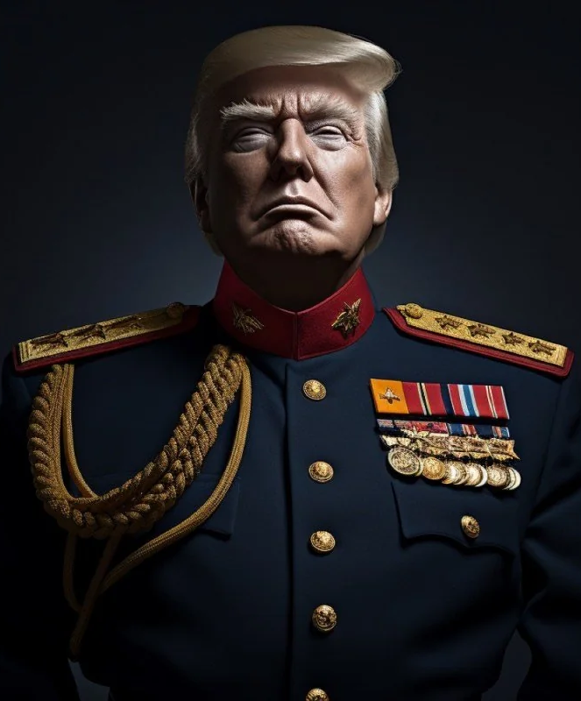
SOCRATIC METHODISTS
QUESTION FOR TODAY’S SESSION
WHAT DO YOU DO WHEN THE PRESIDENT OF THE UNITED STATES IS A TYRANT AND DICTATOR WHO APPEARS TO BE ATTEMPTING TO ESTABLISH A DICTATORSHIP?

Slide 6
IS THAT EVEN A FAIR QUESTION? BASIC DEFINITIONS FROM OXFORD LANGUAGES DICTIONARY
TYRANT = A CRUEL AND OPPRESSIVE LEADER
DICTATOR = A PERSON WHO BEHAVES IN AN AUTOCRATIC WAY BASED ON THE PRINCIPLE: “THIS IS THE WAY WE ARE GOING TO DO IT”; (BRITTANICA) A SINGLE PERSON WHO POSSESSES OR SEEKS TO POSSES ABSOLUTE POLITICAL POWER

Slide 7
LET’S TAKE A QUICK OPINION POLL
AGREE OR DISAGREE: TRUMP IS FAITHFULLY EXECUTING THE OFFICE OF PRESIDENT AND IS PROPERLY CARRYING OUT HIS PRESIDENTIAL DUTIES IN COMPLIANCE WITH THE CONSTITUTION OF THE UNITED STATES?
AGREE OR DISAGREE: TRUMP IS A TYRANT AND DICTATOR OR ATTEMPTING TO BECOME A TYRANT AND DICTATOR?
AGREE OR DISAGREE: TRUMP IS ESTABLISHING OR ATTEMPTING TO ESTABLISH HIS PERSONAL DICTATORSHIP IN THE UNITED STATES?

Slide 8
SURVEY OF WHAT SOME POLITICAL NOTEWORTHIES HAVE SAID ON THIS SUBJECT BARACK OBAMA
“We do not need four years of a wannabe king – a wannabe dictator, running around trying to punish his enemies,” 10/24/24. Harris campaign rally in Atlanta
This Photo by Unknown Author is licensed under CC BY-SA-NC

Slide 9
Hillary Clinton
"Trump has said he wants to be a dictator on Day 1. How could anybody who has watched him not know that that’s what he wants to do? ... He wants unaccountable power," she continued. "He wants to be the person who has almost complete control over the country in a way that we have never imagined.
09/26/24 Interview in Hartford Connecticut for her Book

Slide 10
LIZ CHENEY
"This is how dictators destroy free nations. They threaten those who speak against them with death,"
"We cannot entrust our country and our freedom to a petty, vindictive, cruel, unstable man who wants to be a tyrant.“
11/01/24. Her response to Trump saying she should be put in the line of fire . Cheney post on X.

Slide 11
Former Top Trump Military Advisor & his former white house chief of staff
GENERAL JOHN KELLY: FORMER TRUMP WHITE HOUSE CHIEF OF STAFF: “TRUMP FITS INTO THE GENERAL DEFINiTION OF FASCIST”. “HE CERTAINLY PREFERS THE DICTATOR APPROACH TO GOVERNMENT.”
GENERAL MARK MILLEY: TRUMP’S FORMER CHAIRMAN OF THE JOINT CHIEFS OF STAFF:
“TRUMP IS THE MOST DANGEROUS PERSON IN THE COUNTRY AND IS FASCIST TO THE CORE”

Slide 12
ACTION PLAN BEING PURSUED AT PRESENT
LOBBYING THE KING COUNTY COUNCIL TO INTRODUCE A PROPOSED RESOLUTION
GOAL: FOR COUNCIL TO HOLD INVESTIGATIVE HEARINGS & PUBLIC DEBATE ON CERTAIN LEGISLATIVE QUESTIONS &MAKE FINDINGS ON THOSE QUESTIONS
Receive Testimony from academic experts in Constitutional Law; Political Philosophy & Science; U.S. Political History; and interested members of the Public, to determine:
1. Is Trump establishing or attempting to establish a dictatorship?
2. If so, does our Constitutional System accommodate the establishment of dictatorship?
3. If our Constitutional System does not accommodate the establishment of dictatorship, what actions, if any, should & can the King County Council take in compliance with each member’s oath to uphold the Constitution of the United States?
9 Members: 7 Democrats and 2 Republicans. They are elected representatives of the 2.26 million King County residents, including all Seattle’s.

Slide 13
WHY THE KING COUNTY COUNCIL?

Slide 14
LARGE CONSTITUENCY AS A REPRESENTATIVE LEGISLATIVE BODY. 2.26 MILLION RESIDENTS OF KING COUNTY
30% OF THE ENTIRE STATE OF WASHINGTON POPULATION
HAS THREE TIMES THE POPULATION OF 7TH CONGRESSIONAL DISTRICT & THREE TIMES THE POPULATION OF CITY OF SEATTLE – 3 TIMES THE DEMOCRATIC REPRESENTATION OF THE CITY OF SEATTLE COUNCIL
IT IS BY FAR THE MOST POPULOUS COUNTY OF THE 39 WASHINGTON STATE COUNTIES. GREATER POPULATION THAN 99.7% OF 3144 COUNTIES IN USA.
IT IS THE 12TH MOST POPULOUS COUNTY OF THE 3144 COUNTIES IN THE USA
7 OF THE 9 MEMBERS ARE DEMOCRATS SO THEY HAVE A SUPER MAJORITY (MORE THAN 2/3RDS AND CAN OVERRIDE ANY EXECUTIVE VETO
AND SEVERAL MEMBERS HAVE ALREADY EXPRESSED SYMPATHY FOR TAKING LEGISLATIVE ACTIONS ON TRUMP. ACCESSIBILITY

Slide 15
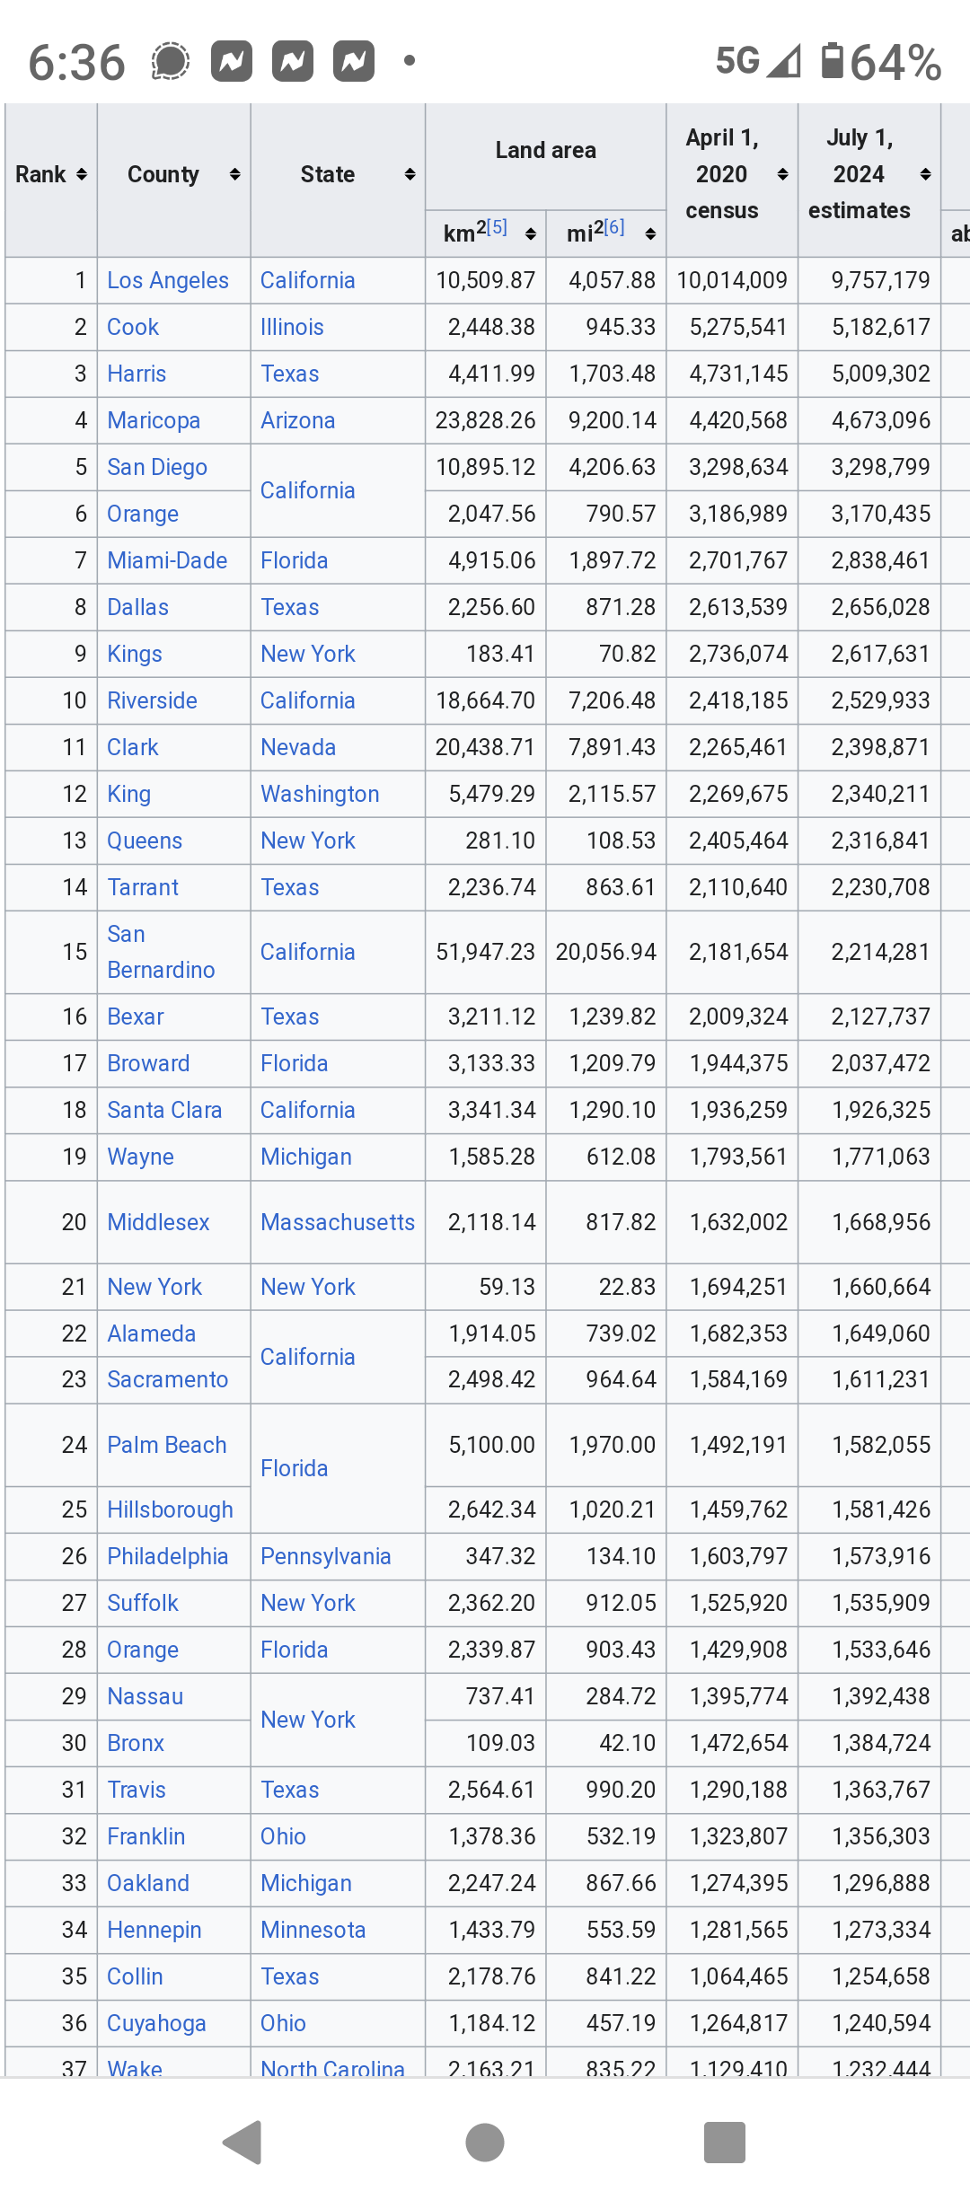

Slide 16
KING COUNTY HAS A GREATER POPULATION THAN 14 STATES
1. Wyoming: 576,851 11. Hawaii: 1,449,885
Vermont: 643,077 12. West Virginia: 1,793,716
Alaska: 733,391 13. Idaho: 1,866,000
North Dakota: 779,094 14. Nebraska: 1,961,266
South Dakota: 886,667
Delaware: 989,948
Montana: 1,084,225
Rhode Island: 1,097,379
Maine: 1,362,359
New Hampshire: 1,377,529

Slide 17
WHAT ARE THE POLITICAL OBJECTIVES AND WHY SHOULD IT BE PURSUED?

Slide 18
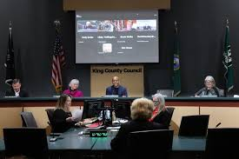
PUBLIC DEBATE ABOUT WHETHER TRUMP IS ATTEMPTING TO ESTABLISH A DICATORSHIP & WHETHER SUCH AN ATTEMPT IS ACCOMODATED BY OUR CONSTITUTIONAL SYSTEM
PUBLIC HEARINGS TO ADDRESS ISSUES WITH TESTIMONY FROM EXPERTS IN CONSTITUTIONAL LAW, POLITICAL PHILOSOPHY, U.S. POLITICAL HISTORY, & FROM THE PUBLIC
FORCE THE KING COUNTY COUNCIL TO MAKE LEGISLATIVE FINDINGS

Slide 19
OBJECTIVE IS FOR COUNCIL TO MAKE LEGISLATIVE FINDINGS, BASED ON PUBLIC TESTIMONY AND EVIDENCE ON FOLLOWING QUESTIONS:
IS TRUMP ATTEMPTING TO ESTABLISH A POLITICAL DICTATORSHIP THROUGH THE ABUSE OF PRESIDENTIAL AUTHORITY AND POWER?
IF SO, DOES THE U.S. CONSTITUTION ACCOMMODATE THAT ATTEMPT?
IF THE U.S. CONSTITUTION DOES NOT ACCOMMODATE THAT ATTEMPT, WHAT ACTIONS IF ANY IS THE KING COUNCIL WILLING AND ABLE TO TAKE IN ORDER TO FULFILL THE OATH OF THE COUNCIL’S MEMBERS TO UPHOLD THE CONSTITUTION OF THE UNITED STATES?

Slide 20
WHY IS IT IMPORTANT TO HAVE LEGISLATIVE BODIES MAKE LEGISLATIVE FINDINGS ABOUT THESE ISSUES?
BECAUSE THAT IS HOW AMERICAN DEMOCRACY IS SUPPOSED TO WORK? THE WILL AND SENTIMENTS OF THE PEOPLE ARE EXPRESSED THROUGH AND BY THE DEMOCRATIC INSTITUTIONS THAT REPRESENT THEM & WHICH IS WHAT WE ELECT THEM TO DO.

Slide 21
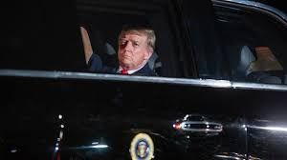
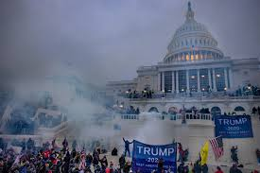
ULTIMATE OBJECTIVES
MORAL AUTHORITY VERSUS CONSTITUTIONAL & STATUTORY AUTHORITY
ENCOURAGE OTHER CITY & COUNTY COUNCILS TO FOLLOW THE EXAMPLE OF THE KING COUNTY COUNCIL (3,144 County Councils; over 30,000 City Councils)
OBTAIN SIGNIFICANT LOCAL AND MASS MEDIA COVERAGE
ATTACK AND UNDERMINE THE TRUMP REGIME LAWFULLY AND IN THE SPHERE OF “MORAL AUTHORITY”

